Slide 1
Contagion – Disease Spreading Modelling as Complex Networks
Jannis Kleine-Schönepauck
Seminar Presentation – Complex Network Dynamics
Supervisor: Nora Molkenthin

Slide 2
Introduction What‘s the importance of understanding how disease spread?
Past two years of COVID-19 pandemic showed the importance of disease control for reaching different public health goals (i.e., prevent infections until a vaccine arrives, limiting stress on healthcare system, …)
But to control a disease, the infection dynamics need to be tangible. Information can be…
Predicting epidemic parameters like the reproductive number R₍₀₎
Whether and when to expect threshold behavior
Having a (holistic) model that emulates the real scenario as good as possible

Slide 3
Contents
Introduction
Characterization of Contagion Model…
On Individual Level (Local Diffusion)
On Global Scale
Derived Containment Strategies
Gillespie Algorithm
Conclusion and Outlook

Slide 4
Contagion Model On An Individual Level ¹ (or Local Diffusion)
Individual Level = Looking at disease transmission from person to person
Now, assumptions have to be made, i.e.
Social network is scale-free
Disease grants immunity after infection
Infinite-size population
Negation of these statements can also theoretically be modelled!
Human Contact
(Edge)
Single Person
(Node)
SIR model
Case 1
(May & Lloyd)¹
Notes:
Another assumption being random mixing vs assortative mixing

Slide 5
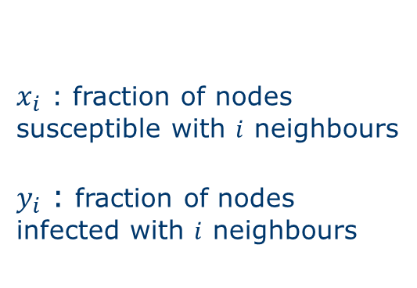
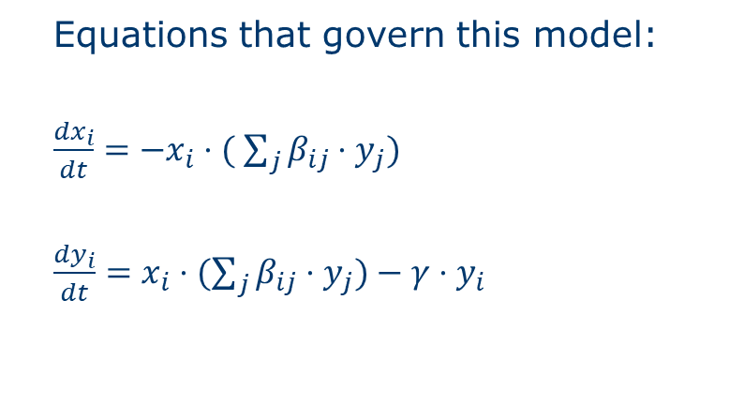
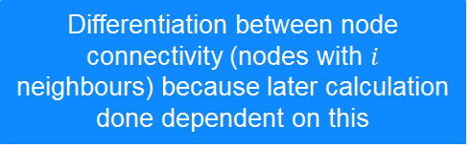
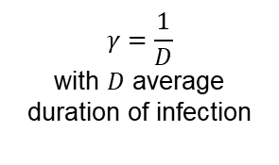
Contagion Model On An Individual Level ¹ (or Local Diffusion)
Equations that govern this model:
$\frac{{dx}_{i}}{dt}=−x_{i}⋅( \sum_{j}{β_{ij}⋅y_{j})}$
$\frac{dy_{i}}{dt}=x_{i}⋅(\sum_{j}{β_{ij}{⋅y}_{j})−γ⋅y_{i}}$
$x_{i}$ : fraction of nodes susceptible with $i$ neighbours
$y_{i}$ : fraction of nodes infected with $i$ neighbours
Infection Rates
Recovery Rate
$$γ=\frac{1}{D}$$
with $D$ average duration of infection
Differentiation between node connectivity (nodes with $i$ neighbours) because later calculation done dependent on this

Slide 6
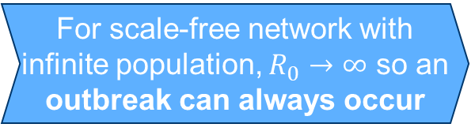
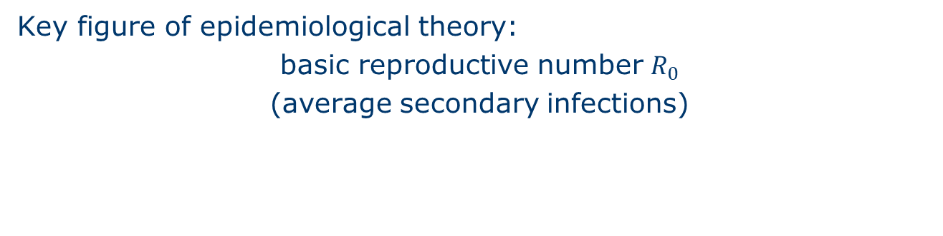

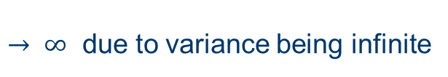

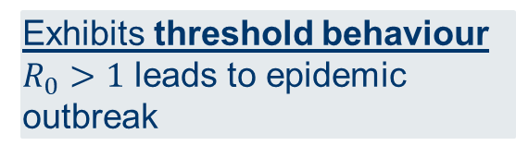
Contagion Model On An Individual Level ¹
Case 1
(May & Lloyd) ¹
Key figure of epidemiological theory:
basic reproductive number $R_{0}$
(average secondary infections)
For defined heterogenous networks:
$$R_{0}=ρ_{0}{\left(1+{(C}_{V}\right)}^{2})$$
with
$ρ_{0}=βD<k>$
(average nr of infections by single infected into naive population)
$$C_{V}=\frac{<k^{2}>−<k>^{2}}{<k>^{2}}$$
(coefficient of variation of connectivity distribution)
Exhibits threshold behaviour
$R_{0}>1$ leads to epidemic outbreak
$$→ ∞$$
For scale-free network with infinite population, $R_{0}→∞$ so an outbreak can always occur
$→ ∞$ due to variance being infinite
Notes:
Is scale-free network → node-connectivity distribution $P(k)\sim k^{−ν}$
SIR model more suitable for many epidemiological situations

Slide 7
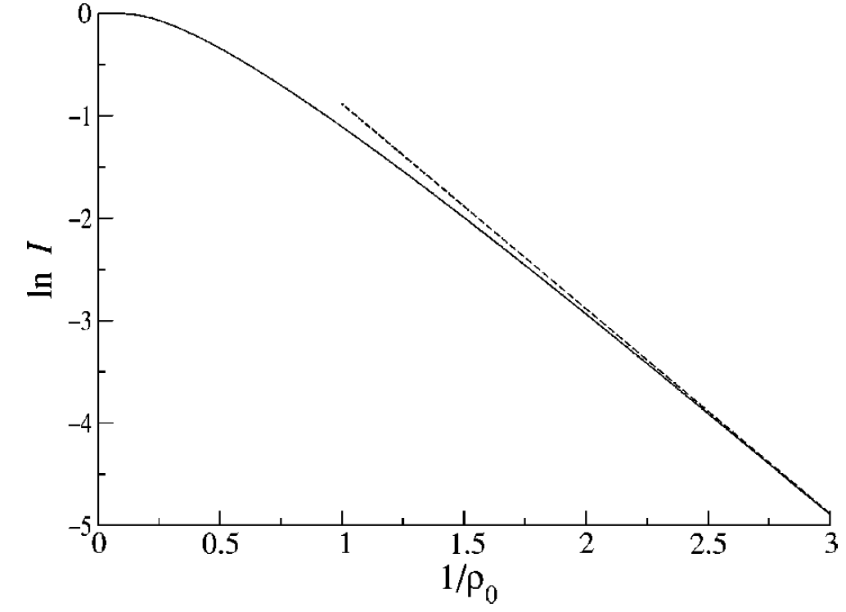
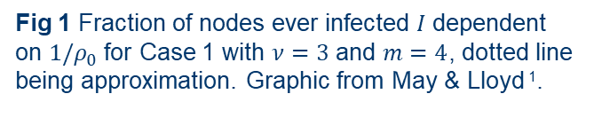
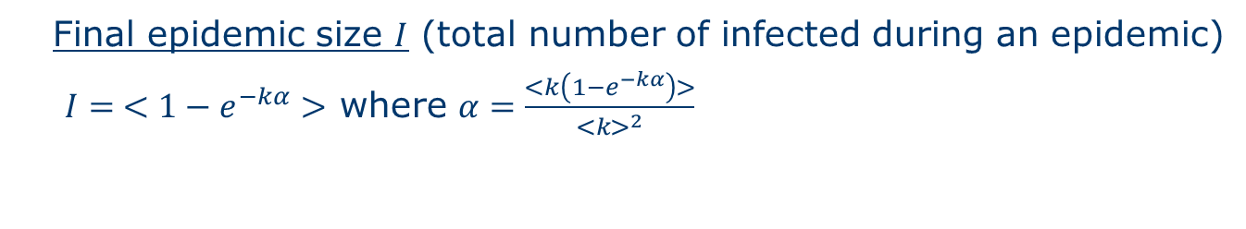
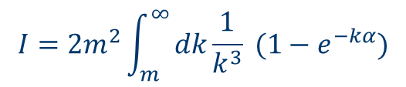
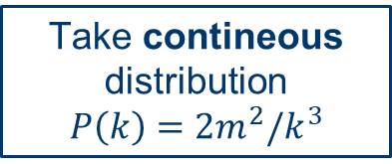
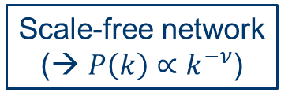
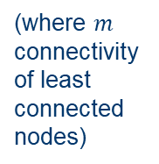
Contagion Model On An Individual Level ¹ Further important metrics…
Final epidemic size $I$ (total number of infected during an epidemic)
$I= <1−e^{−kα}>$ where $α=\frac{<k\left(1−e^{−kα}\right)>}{<k>^{2}}$
Scale-free network
(→ $P\left(k\right)∝k^{−ν}$)
Take contineous distribution
$$P\left(k\right)=2m^{2}/k^{3}$$
(where $m$
connectivity
of least connected
nodes)
Case 1
(May & Lloyd) ¹
$$I=2m^{2}\int_{m}^{∞}{dk\frac{1}{k^{3}} (1−e^{−kα})}$$
Fig 1 Fraction of nodes ever infected $I$ dependent on ${1/ρ}_{0}$ for Case 1 with $ν=3$ and $m=4$, dotted line being approximation. Graphic from May & Lloyd ¹.
Notes:
Approximation of rho<<1 valid

Slide 8
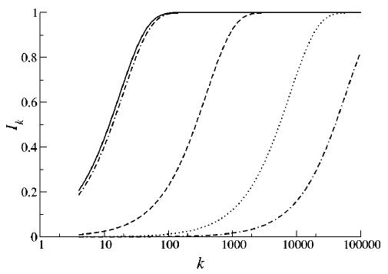

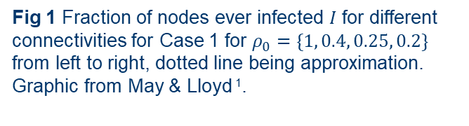
Contagion Model On An Individual Level ¹ Further important metrics…
Fraction of Nodes ever infected and differentiating between connectivity $k$
→ set of nodes with lower
connectivity have mostly
significantly fewer infections
→ at certain connectivity,
practically all nodes will be
infected (depending on $ρ_{0}$)
Fig 1 Fraction of nodes ever infected $I$ for different connectivities for Case 1 for $ρ_{0}=\{1, 0.4, 0.25, 0.2\}$ from left to right, dotted line being approximation. Graphic from May & Lloyd ¹.
Notes:
Approximation of rho<<1 valid

Slide 9
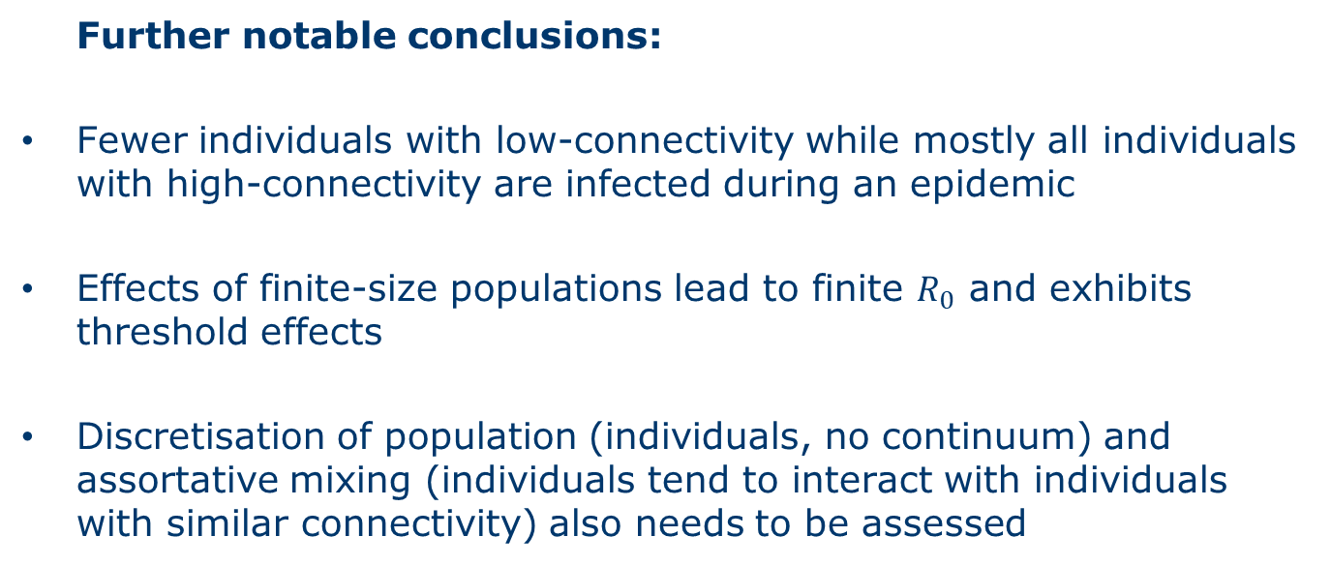
Contagion Model On An Individual Level ¹
Further notable conclusions:
Fewer individuals with low-connectivity while mostly all individuals with high-connectivity are infected during an epidemic
Effects of finite-size populations lead to finite $R_{0}$ and exhibits threshold effects
Discretisation of population (individuals, no continuum) and assortative mixing (individuals tend to interact with individuals with similar connectivity) also needs to be assessed
But this model is still deterministic, not stochastic!
Notes:
SIR (Suseptible-Infected-Recovered) and SIS (Suseptible-Infected-Suseptible) model have different properties, namely:
SIS model exhibits no threshold behaviour on scale-free networks

Slide 10
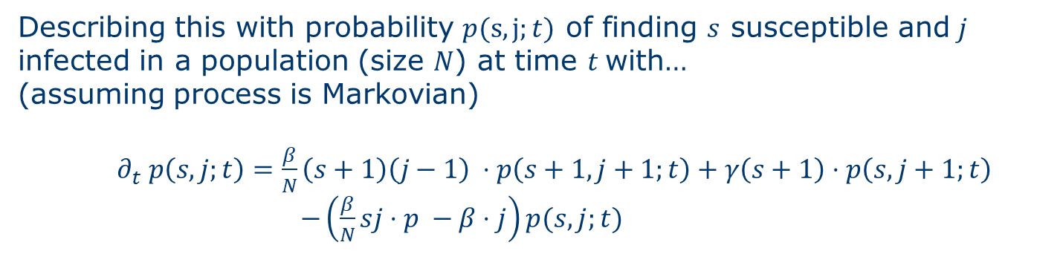
Contagion Model On A Global Scale ²
Perspective so far on temporal development…
What about geographical spread and occurring spatial effects?
What about transmission and recovery being stochastic and lack of fluctuation?
Describing this with probability $p(s,j;t)$ of finding $s$ susceptible and $j$ infected in a population (size $N$) at time $t$with…
(assuming process is Markovian)
$∂_{t} p\left(s,j;t\right)=\frac{β}{N}\left(s+1\right)\left(j−1\right) ⋅p\left(s+1,j+1;t\right)+γ\left(s+1\right)⋅p\left(s,j+1;t\right)$
$−\left(\frac{β}{N}sj⋅p −β⋅j\right)p(s,j;t)$
Master
equation
+ initial conditions
² Forecast and control of epidemics in a globalized world: Hufnagel L, Brockmann D, Geisel T (2004)

Slide 11
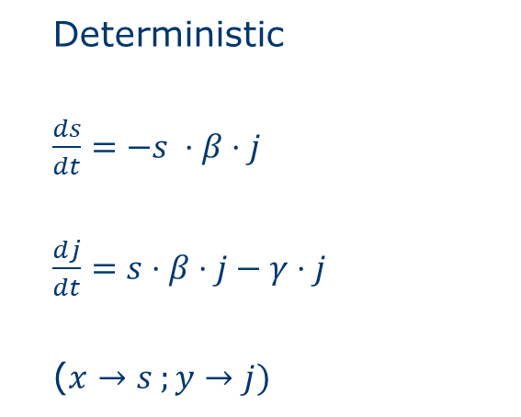
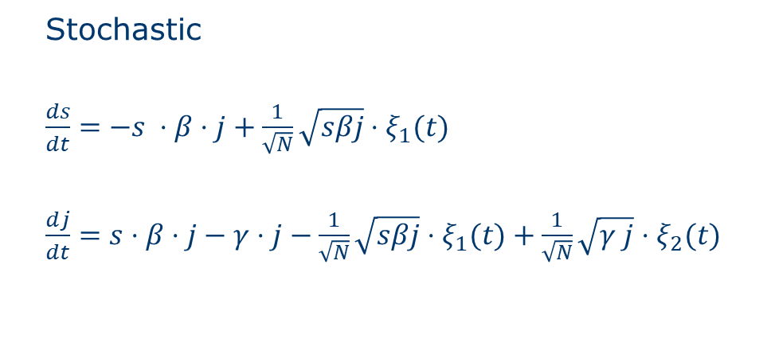
Contagion Model On A Global Scale ²
For large but finite population, one can approximate (for large but finite populations):
Gaussian white noise
(fluctuations)
Deterministic
$\frac{ds}{dt}=−s ⋅β⋅j$
$\frac{dj}{dt}=s⋅β⋅j−γ⋅j$
($x→s ;y→j)$
Stochastic
$\frac{ds}{dt}=−s ⋅β⋅j+\frac{1}{\sqrt{N}}\sqrt{sβj}⋅ξ_{1}(t)$
$\frac{dj}{dt}=s⋅β⋅j−γ⋅j−\frac{1}{\sqrt{N}}\sqrt{sβj}⋅ξ_{1}(t)+\frac{1}{\sqrt{N}}\sqrt{γ j}⋅ξ_{2}(t)$
(for comparison)
² Forecast and control of epidemics in a globalized world: Hufnagel L, Brockmann D, Geisel T (2004)

Slide 12




Contagion Model On A Global Scale ²
Global Scale → quantifying the dispersals through aviation network
Transition from population $i$ to $j$ with transition matrix $Ψ_{ij}$
+
Assuming, individuals remain in urban area for some time
+
Time dependent $ρ_{0}(t)$
Flight route
(Edge)
Population $i$
with $N_{i}$ individuals
total of M
populations
Stochastic model for local dispersion
Local Urban Population
(Node)
Case 2
(Hufnagel, Brockmann & Geisel)
² Forecast and control of epidemics in a globalized world: Hufnagel L, Brockmann D, Geisel T (2004)

Slide 13
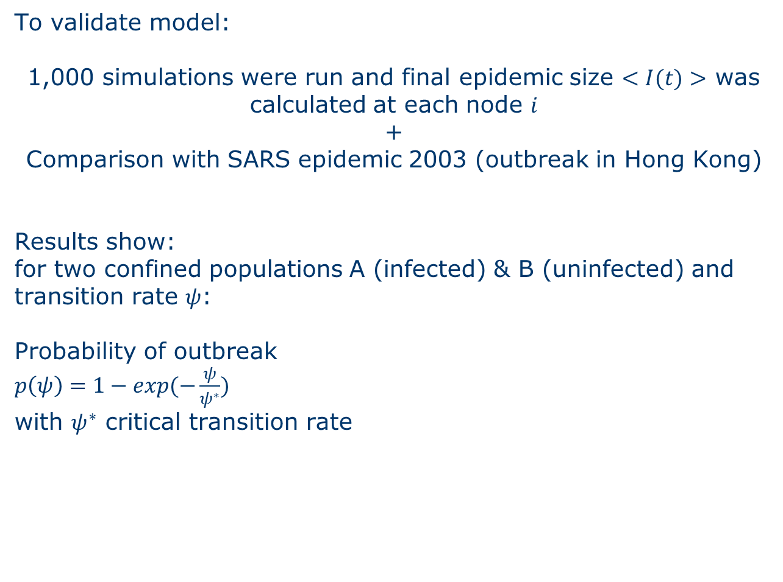
Contagion Model On A Global Scale ²
Case 2
(Hufnagel, Brockmann & Geisel) ²
To validate model:
1,000 simulations were run and final epidemic size $<I(t)>$ was calculated at each node $i$
+
Comparison with SARS epidemic 2003 (outbreak in Hong Kong)
Results show:
for two confined populations A (infected) & B (uninfected) and transition rate $ψ$:
Probability of outbreak
$p\left(ψ\right)=1−exp(−\frac{ψ}{ψ^{∗}})$
with $ψ^{∗}$ critical transition rate
Notes:
Almost perfect prediction of countries infected
Good overlap regarding magnitude of final epidemic size
Delay until outbreak in B arrives also stochastic variable (distribution) → lag time T

Slide 14
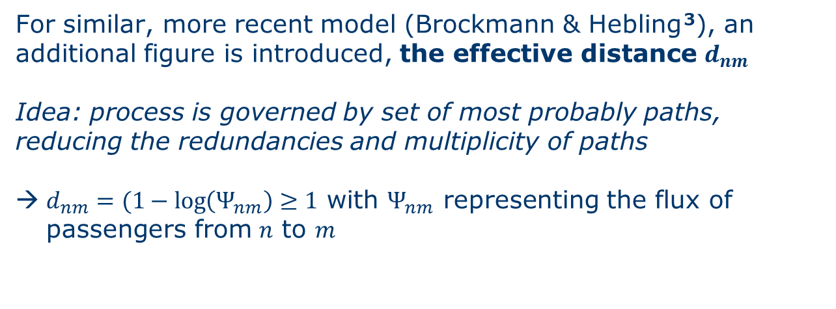

Contagion Model On A Global Scale ³
For similar, more recent model (Brockmann & Hebling ³), an additional figure is introduced, the effective distance $d_{nm}$
Idea: process is governed by set of most probably paths, reducing the redundancies and multiplicity of paths
$d_{nm}=(1−\log\left(Ψ_{nm}\right)≥1$ with $Ψ_{nm}$ representing the flux of passengers from $n$ to $m$
$$d_{nm}≠d_{mn}$$
Notes:
Almost perfect prediction of countries infected
Good overlap regarding magnitude of final epidemic size
Delay until outbreak in B arrives also stochastic variable (distribution) → lag time T

Slide 15
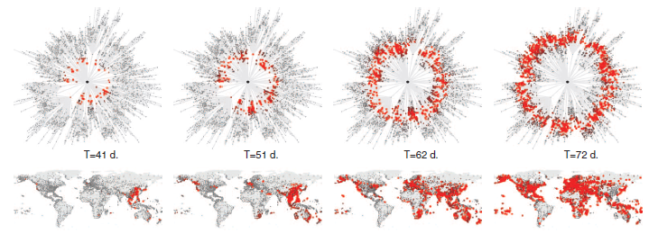
Contagion Model On A Global Scale ³
Graphic representation of effective distance reveals the otherwise not noticeable wavefront of epidemic;
here modelled for disease starting in Hong Kong
Fig 2 Visual representation of spread of simulated disease, redness signaling significant prevalence, with outbreak in Hong Kong. Representation with effective distance (top, radial distance equals effective distance) or geographical (bottom). Graphic from Brockmann & Helbring ³.
Notes:
Robust against variation in epidemic parameters
Calculation of spreading speed and arrival times, linking epidemiological and mobility parameters
Only dependent on static mobility matrix

Slide 16
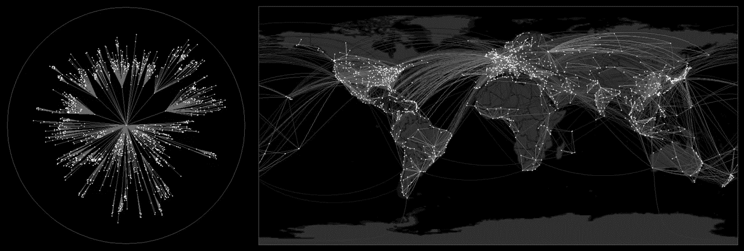
Contagion Model On A Global Scale ³
Fig 3 Visual video-based representation of spread of simulated disease, redness signaling significant prevalence, with outbreak in Atlanta. Representation with effective distance (left) or geographical (right).
Video via https://rocs.hu-berlin.de/project/viz-event-horizon/ by Dirk Brockmann; referencing Brockmann & Helbring ³.
Notes:
Robust against variation in epidemic parameters
Calculation of spreading speed and arrival times, linking epidemiological and mobility parameters
Only dependent on static mobility matrix

Slide 17
Derived Containment Strategies ^{1,2,3} (selection only)
Containment strategies most effective when targeted towards highly connected individuals (vs random)
Using for example vaccinations to reduce the effective reproductive number below threshold of 1
Global Mobility Network can be used to estimate percentage of vaccinations needed to prevent an epidemic spread
Quick response to initial outbreak necessary to prevent need for global vaccination
Prediction of arrival time can help estimate when to impose preventive containment measure
Local duffison processes
On Global Scale
¹ Infection dynamics on scale-free networks: May & Lloyd (2001)
² Forecast and control of epidemics in a globalized world: Hufnagel L, Brockmann D, Geisel T (2004)
³ The Hidden Geometry of Complex, Network-Driven Contagion Phenomena: Brockmann D, Helbring D (2013)
Notes:
Isolation of 2% of largest cities drastically reduces % needed to be vaccinated from 74.6% to 37.5%
Shutting down strongest connections not as effective, top 27.5% of connections would need to be taken off the network

Slide 18
Gillespie Algorithm And Spreading Models ⁴
Previous stochastic models often used equidistant time steps and transition rates and looked at whether a possible event took place after that time increment (Monte-Carlo Simulation)
Gillespie Algorithm instead replicates a continuous-time process and uses the time until the next event takes place and therefore improving computational time
However, application to non-static networks (such as spreading) not trivial, yet possible
Notes:
Robust against variation in epidemic parameters
Calculation of spreading speed and arrival times, linking epidemiological and mobility parameters
Only dependent on static mobility matrix
https://www.atlantis-press.com/article/55917249.pdf

Slide 19



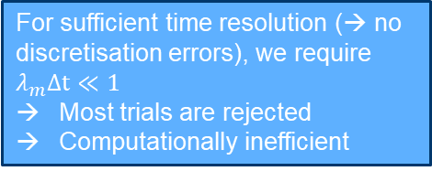
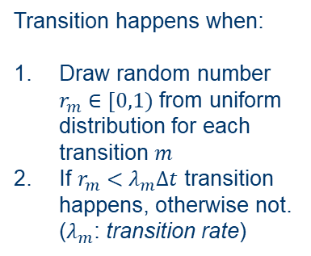

Gillespie Algorithm And Spreading Models ⁴
Monte Carlo Gillespie Algorithm
Evaluate whether transition $m$ happened
For Poisson processes in static networks, probability that transition $m$ didn‘t happen after time $τ$:
$$S_{m}\left(τ\right)=e^{−λ_{m}τ}$$
Probability, that no transitions happened after $τ$:
$S\left(τ\right)=e^{−Λτ}$ with $Λ=\sum_{m=1}^{M}{λ_{m}}$
Draw $τ$ from distribution of waiting times $τ$ (probability density):
$$p\left(τ\right)=Λ⋅e^{−Λτ}$$
or for transition $m$:
$$p\left(τ\right)=λ_{m}⋅e^{−Λτ}$$
$$∆t$$
For Poisson processes in static networks, probability that transition $m$ didn‘t happen after time $τ$:
$$S_{m}\left(τ\right)=e^{−λ_{m}τ}$$
Probability, that no transitions happened after $τ$:
$S\left(τ\right)=e^{−Λτ}$ with $Λ=\sum_{m=1}^{M}{λ_{m}}$
Draw $τ$ from distribution of waiting times $τ$ (probability density):
$$p\left(τ\right)=Λ⋅e^{−Λτ}$$
or for transition $m$:
$$p\left(τ\right)=λ_{m}⋅e^{−Λτ}$$
Transition happens when:
Draw random number $r_{m}∈[0,1)$ from uniform distribution for each transition $m$
If $r_{m}<λ_{m}Δt$ transition happens, otherwise not. ($λ_{m}$: transition rate)
transition rate
Transition happening
Cumulative transition rate
For sufficient time resolution (→ no discretisation errors), we require $λ_{m}Δt≪1$
Most trials are rejected
Computationally inefficient
$$t$$
$$t$$

Slide 20
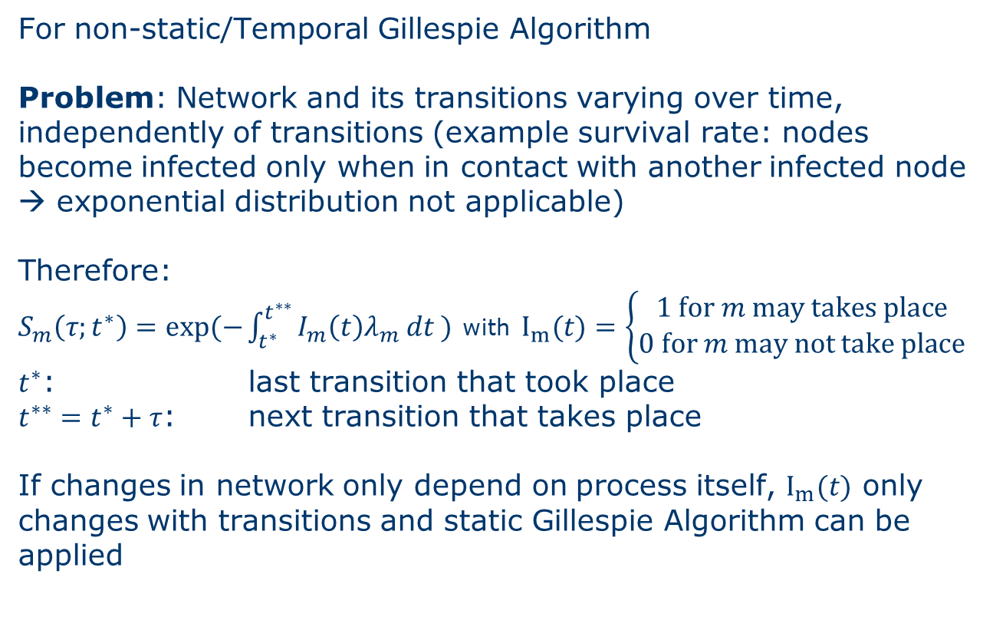
Gillespie Algorithm And Spreading Models ⁴
For non-static/Temporal Gillespie Algorithm
Problem: Network and its transitions varying over time, independently of transitions (example survival rate: nodes become infected only when in contact with another infected node → exponential distribution not applicable)
Therefore:
$S_{m}\left(τ;t^{∗}\right)=exp⁡(−\int_{t^{∗}}^{t^{∗∗}}{I_{m}\left(t\right)λ_{m} dt )}$ with $I_{m}(t)=\left\{\begin{aligned}1 for m may takes place \\ &0 for m may not take place\end{aligned}\right.$
$t^{∗}$: last transition that took place
$t^{∗∗}=t^{∗}+τ$: next transition that takes place
If changes in network only depend on process itself, $I_{m}(t)$ only changes with transitions and static Gillespie Algorithm can be applied

Slide 21
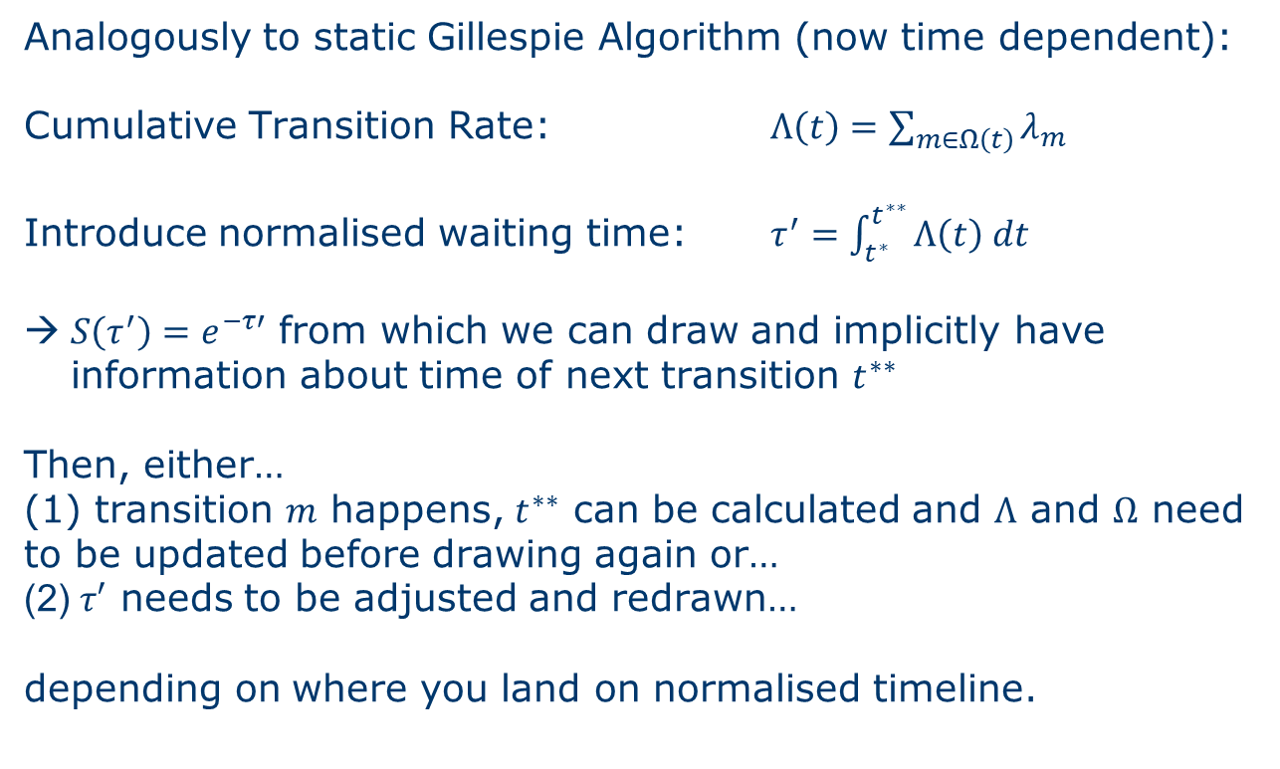
Gillespie Algorithm And Spreading Models ⁴
Analogously to static Gillespie Algorithm (now time dependent):
Cumulative Transition Rate: $Λ\left(t\right)=\sum_{m∈Ω\left(t\right)}{λ_{m}}$
Introduce normalised waiting time: $τ^{′}=\int_{t^{∗}}^{t^{∗∗}}{Λ\left(t\right) dt}$
$S\left(τ^{′}\right)=e^{−τ′}$ from which we can draw and implicitly have information about time of next transition $t^{∗∗}$
Then, either…
(1) transition $m$ happens, $t^{∗∗}$ can be calculated and $Λ$ and $Ω$ need to be updated before drawing again or…
(2) $τ′$ needs to be adjusted and redrawn…
depending on where you land on normalised timeline.

Slide 22
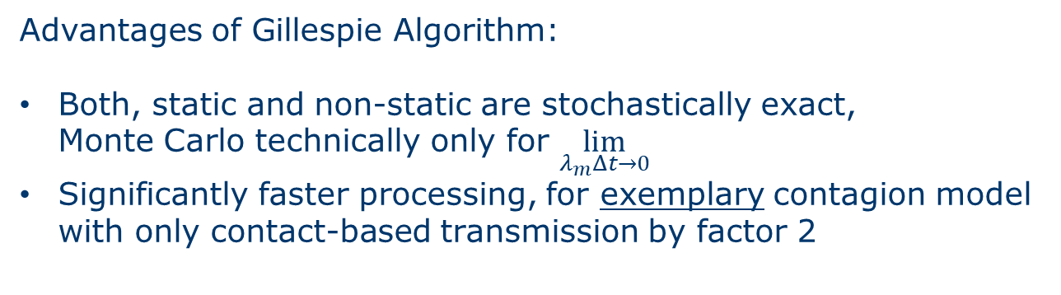
Gillespie Algorithm And Spreading Models ⁴
Advantages of Gillespie Algorithm:
Both, static and non-static are stochastically exact, Monte Carlo technically only for $\lim_{λ_{m}Δt→0}$
Significantly faster processing, for exemplary contagion model with only contact-based transmission by factor 2

Slide 23
Conclusion and Outlook ^{1,2,3}
Contagion Models exist in various forms like…
… for local diffusion processes:
… for today’s global scale spreading processes:
where for infinitely large populations no threshold behavior is noticeable
where final epidemic size can be exactly and approx. calculated
where the modelling of the global mobility network leads to improvement of the quality of prediction
where relative distance can reveal properties like wavefronts in the network
¹ Infection dynamics on scale-free networks: May & Lloyd (2001)
² Forecast and control of epidemics in a globalized world: Hufnagel L, Brockmann D, Geisel T (2004)
³ The Hidden Geometry of Complex, Network-Driven Contagion Phenomena: Brockmann D, Helbring D (2013)

Slide 24
Conclusion and Outlook ^{1,2,3}
Different containment measures then can be deducted from these models, respectively, which in a future step could be evaluated with regards to the current pandemic.
Furthermore, quality of models and computational time can always be further advanced.
One problem of interest may be impact evaluation of different containment measures where the current pandemic could again serve as a point of reference
¹ Infection dynamics on scale-free networks: May & Lloyd (2001)
² Forecast and control of epidemics in a globalized world: Hufnagel L, Brockmann D, Geisel T (2004)
³ The Hidden Geometry of Complex, Network-Driven Contagion Phenomena: Brockmann D, Helbring D (2013)

Slide 25
Conclusion and Outlook ⁴
Additionally, advantages of the Gillespie Algorithm vs rejection sampling models (Monte Carlo) has been shown
Deeper investigation of the computational superiority could be another topic for future research
⁴ Temporal Gillespie Algorithm: Fast Simulation of Contagion Processes on Time Varying Networks: Vestergaard CL, Génois M (2015)

Slide 26
Bibliography
Infection Dynamics on scale-free networks: May RM, Lloyd AL. Physical Review E. Vol 64 (2001). DOI: 10.1103/PhysRevE.64.066112
Forecast and control of epidemics in a globalized world: Hufnagel L, Brockmann D, Geisel T. PNAS. Vol 101(42). p. 15124 – 15129 (2004). www.pnas.org/cgi/doi/10.1073/pnas.0308344101
The Hidden Geometry of Complex, Network-Driven Contagion Phenomena: Brockmann D, Helbing D. Science Vol 343 (2013). DOI: 10.1126/science.1245200
Temporal Gillespie Algorithm: Fast Simulation of Contagion Processes on Time Varying Networks. Verstergaard CL, Génois M. PLOS Computational Biology (2015). DOI:10.1371/journal.pcbi.1004579

